Slide 1


Slide 2

Selecting a College

Slide 3

Selecting a College Includes…
Academic Goals
Social Goals
Career Goals

Slide 4





What are your options?
Vocational/Technical School
2-year Community College
4-year University

Slide 5

Let’s Share our Plans!
Think about:
Majors offered
Types of programs
Location of schools
Make the best decision for YOU!

Slide 6
Choosing a Major
What majors are offered to strongly meet needs
What are the academic requirements
What learning opportunities are available
What job-placement services are provided

Slide 7
Vocational/Technical School
Technical Diploma
Quick way to gain skills and find a job efficiently
Required by over 83% of the jobs in the workforce
Continue your education with a college or university if you choose to do so while working
What to do:
Review the programs and classes – usually 18-24 months in length
Complete enrollment requirements
Fill out an application (Online or Print)
Talk with Student Services
Apply for financial aid = tuition, books, expenses

Slide 8

Going to Postsecondary School?
What Fits?
Type of School
Location
Size of the School
Cost and Financial Aid
Campus Activities
Majors Offered

Slide 9
Top 10 Jobs for Getting Ahead
Occupation | Median Base Salary | Job Openings
Hospitalist | $222,000 | 1000+ (87%)
Pharmacist | $123,000 | 3300+ (45%)
3. Sales Engineer | $80,000 | 3000+ (159%)
4. Site Reliability Engineer | $140,000 | 3000+ (93%)
5. Product Manager | $97,500 | 3000+ (11%)
6. Financial Analyst | $64,000 | 2500+ (27%)
7. Technical Program Mgr | $129,000 | 500+ (49%)
8. Program Manager | $97,400 | 2300+ (17%)
9. Data Engineer | $105,000 | 900+ (85%)
10. Scrum Master | $100,000 | 400+ (104%)

Slide 10




Research
Attend College Fairs
Research online
Talk with School Counselor
Campus Visits

Slide 11

Going to School after High School
The Campus Visit
Call ahead
Take notes
Visit residence halls
Talk to current students
Meet with faculty
Sit in on a class
ASK QUESTIONS!
Make the most of your visit!

Slide 12

Going to School After High School
The Campus Visit
Cost of Attendance?
Housing Policy?
Scholarships & Financial Aid?
Activities & Social Groups?
Meal Plan?

Slide 13
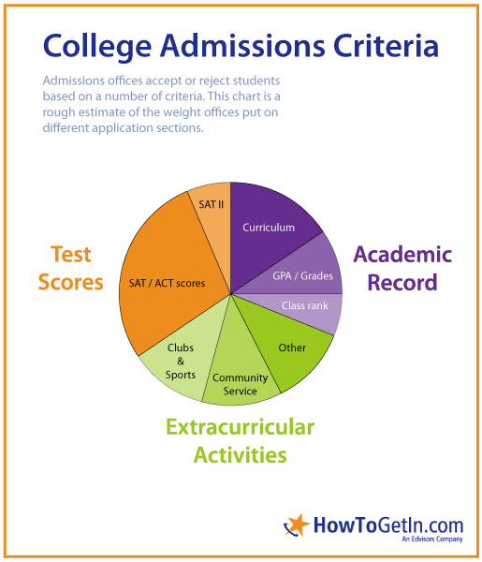

Slide 14

Getting into College
What do colleges look for in an applicant?
Letters of recommendation
Rigor of Secondary School Record
Character/Personal Qualities
Extracurricular Activities
ACT/SAT
Academic GPA
Essay
Particular Talent /Ability
Social media
Class Rank

Slide 15



Begin your college search by viewing virtual tours of over 1,300 college campuses!

Slide 16

eCampusTours e-mail service reminds students about important deadlines and provides helpful college planning articles and tips.
Students are sent dynamic content based upon their year in school.
eCampusTours articles have been reprinted in college planning magazines throughout the country.

Slide 17

Types of Classes
Regular on-campus
Satellite campuses
Online

Slide 18
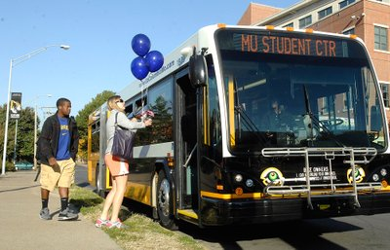
Campus Resources
Health Center
Counseling Center
Career Center
Tutoring
Day Care
Recreation Center
Transportation
Computer labs
Library

Slide 19

Other Educational Opportunities
Internships
Study abroad
Co-op Programs

Slide 20

Tips for Making the Application Process Easier
Make an electronic portfolio to keep track of college view books, applications, test results, resumes, recommendations, etc.
Create a Word document with activities, addresses, and details needed on the application. This makes it is easy for you to copy and paste information into the application.

Slide 21

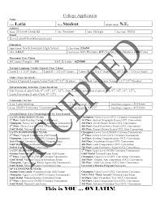
Completing
the
Application
In general, the more selective the college, the more complicated the application will be.
Complete the application online.
Read instructions carefully to be certain you are completing and/or providing ALL requested information.
Keep copies of everything you complete or send.
Always have someone proofread before hitting the send button.

Slide 22


Deadlines
Observe application deadlines.
Keep a calendar of the dates of each deadline in a prominent place.
ALWAYS TRY AND COMPLETE THE APPLICATION TWO WEEKS BEFORE IT IS DUE. THIS PREVENTS CRISIS IF YOUR COMPUTER CRASHES OR POWER IS OUT.

Slide 23

Test Scores
Test scores should be sent to the school before the deadline.
Students are responsible for seeing that the schools they apply to get their scores.
CHECK THIS EARLY as it takes time for SAT or ACT to send the scores if they were not on your initial score report list.
The College Board (SAT, SAT Subject, AP) takes about five weeks to send additional score reports after they are requested and they charge for each.

Slide 24

Recommendation Letters
Most private colleges and a few public colleges require a counselor recommendation (often called a secondary school report).
Give your counselor at least a 2 week notice.

Slide 25
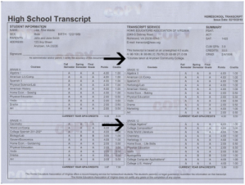
Transcripts
Order and send official transcripts according to the directions from the counseling office.

Slide 26

Essay Writing
Start writing any essay well before the deadline.
A quality essay takes writing, editing, re-writing and can’t be done in a day.
Have a parent, older sibling, or other adult check and re-check the essay.

Slide 27

Application Fees
Application fees for 4-year colleges vary, but usually are around $35.
Schools give you the choice of paying by check or paying online.
Some colleges offer fee waivers for those with limited resources.
Check with each college for the requirements for fee waivers if you think you may qualify. Frequently if you received an SAT/ACT fee waiver, you may qualify for a waiver of the application fee.

Slide 28

Follow-Up
Check with each college to be sure your application file is complete. Some colleges have a way to check the status of your application online and some send you an email confirming a complete application.
Call the admissions office if you have any concerns about the application being received.
Completing applications is like taking on a part-time job. The key is getting organized ahead and not waiting until the last minute.
Finish the applications and then relax!!!

Slide 29


Sample Student Portal

Slide 30


Financial Aid =
MONEY that assists students and families in funding their college education

Slide 31

Definitions of Terms
FAFSA:
Free Application for Federal Student Aid
FSA ID: FEDERAL STUDENT AID ID
The user name and password created to complete the FAFSA
COA: COST OF ATTENDANCE
The total amount it will cost to go to college each year (including tuition, fees, room and board, books, etc.)
EFC: EXPECTED FAMILY CONTIBUTION
Estimate of a family’s ability to contribute to a year of college expenses; used to determine eligibility for financial aid
SAR: STUDENT AID REPORT
Document that gives basic information about your eligibility for financial aid

Slide 32

APPLY EARLY FOR YOUR FSA ID
Parent and Student BOTH need FSA ID’s to submit the FAFSA
Apply for FSA ID 1-3 days prior to FAFSA filing

Slide 33

IMPORTANT TIPS ABOUT YOUR FSA ID
Email Address – – MUST KNOW LOG-IN INFO (YOUR PARENTS NEED A SEPARATE EMAIL AS WELL!)
Create a USERNAME and PASSWORD
SSN and Date of Birth as shown on SS Card
Mailing Address
4 Challenge Questions!
Register your mobile phone number for account recovery using text messages
**The FAFSA is available beginning October 1**

Slide 34


Slide 35

Paying for College
Financial Aid:
Gift Aid
Grants
Federal
State
Institutional
Private

Slide 36

Paying for College
Tennessee Student Assistance Award
(assistance to financially-needy TN residents)
FAFSA deadline: ASAP after October 1. Must be a TN resident. Returning students will be awarded first and then new students with an EFC of 0.
4 yr/2yr private-$4,000
4 yr public-$2,000
2 yr public-$1,300
TCAT-$1,000

Slide 37

Paying for College
Financial Aid: Gift Aid
Scholarships
TN Education Lottery Scholarship Program (HOPE)
TN Promise
Institutional
Ned McWherter Scholars Program
Private

Slide 38
Paying for College
Financial Aid: Gift Aid
Tennessee Education Lottery Scholarship Program
Apply for the lottery scholarship by filling out the FAFSA
www.tn.gov/collegepays
Tennessee HOPE Scholarship for Entering Freshmen:
$3,500/year or $1,750/semester (Freshman & Sophomore) - 4 year
$4,500/year or $2,250/semester (Junior & Senior) – 4 year
$3,000/year or $1,500/semester – 2 year
Award amounts are available for summer enrollment
21 ACT (980 SAT)
3.0 weighted overall GPA
OR

Slide 39

Paying for College
Financial Aid: Gift Aid
Wilder-Naifeh Technical Skills Grant
TN College of Applied Technology
FAFSA Application
$2,000 per year
No ACT or GPA requirement

Slide 40
Paying for College
Financial Aid: Gift Aid
  Tennessee Promise
TCAT, 2-year, 4-year (pursuing an Associate’s degree)
Promise application completed by November 1
FAFSA application completed by January 16
8 hours of community service prior to Fall enrollment and during year
1 mandatory Promise meeting
Mentor

Slide 41
Paying for College
Financial Aid: Self-Help Aid
Employment
Federal Work Study
Campus Employment
Loans
Stafford Loan
Perkins Loan
Parent (PLUS) Loan
Alternative Loans

Slide 42
Paying for College
Financial Aid: How do I apply?
FAFSA – Free Application for Federal Student Aid
College or University
Institutional Aid
Other sources of aid
Outside scholarships and loans
Pell Grant
SEOG
Work Study
Perkins Loan
Stafford Loan
State Aid Programs

Slide 43

Paying for College
FAFSA: Free Application for Federal Student Aid
When…
FAFSA will be available to seniors beginning October 1
How…
Register for FSA ID and complete FAFSA at http://www.fafsa.gov
Remember…
Must reapply
Priority deadlines
Keep copies of everything

Slide 44

Paying for College
How does the FAFSA work?
Students will receive the Student Aid Report (SAR) via email within 3-5 days OR in the mail within 7-10 days with their Expected Family Contribution (EFC).

Slide 45
Paying for College
Financial Aid: The Award Letter
Be sure to check your student portal often. Most approvals will be done electronically!
Based on FAFSA and college aid applications
Details all of the aid you are receiving
Must individually accept/deny all parts of the award
Must return to the college by the deadline
May be other institutional applications to complete
READ CAREFULLY!!!!

Slide 46
Paying for College
Additional Costs to Think About
Start Up Costs (especially if you are going away to school or getting your own place)
Gas to and from school
Comforter, bedding
Microwave
Mini Fridge
Curtains
Computer
And the list goes on and on
Consider saving your graduation money or having a trunk party to assist you in obtaining many of the items you’ll need!

Slide 47

Start early
Request information from schools
Visit campuses
Request applications
Retake ACT or SAT
Search for scholarships
Meet all deadlines
Ask questions
Complete applications
FILE FAFSA October 1
Let’s Review
Fall of your Senior Year

Slide 48
Let’s Review
Spring of your
Senior Year
Complete any scholarship paperwork and community service requirements
Complete remaining paperwork with your college(s) including award letter
Return your intent to enroll to your school of choice (usually by May 1)

Slide 49

Let’s Review
Summer before you enroll
Attend New Student Orientation
Finish any last minute details with your school
Get Ready!!!!!

Slide 50

Top 5 things to learn before you go off to college:
Laundry
Balance a checkbook
Cook basic meals
Time management
Live on a fixed budget

Slide 51

Let’s Review
After you enroll:
Career Services
Internships
Practical Experiences
Get Involved
Ask For Help

Slide 52








@StudentOutreachServices
@eCampusTours
@EdsouthSOS
@eCampusTours
@EdsouthSOS
@eCampusTours
LEARN MORE
@eCampusTours
www.eCampustours.com
www.planningyourdreams.org
www.edsouth.org/SOS
@EdsouthSOS
eCampusTours.tumblr.com
Student Outreach Services from Edsouth

